Slide 1
Business Intelligence and Data Warehousing (ANL408)
- By Sabarish Nair

Slide 2
Recap from last week....
Data Warehouse Architecture
Enterprise Architecture
Federated Architecture
Multi-tiered Architecture
Layers of data warehouse
Staging Layer
Temporary Staging Layer
Persistent Staging Layer
Data Mart
Types of Data Mart
Advantages and Drawbacks of Data Mart
Data Mart vs Data Warehouse

Slide 3
Traditional Data Warehouse
Centralized warehouse repositories within an organization. They are designed to support:
Reporting
Analytics
Business Intelligence
DECISION – MAKING!!!
3

Slide 4
Traditional Warehouse - Characteristics
Structured Data Storage
ETL Processes
Dimensional Modelling
Query and Reporting
Data Marts
Historical Data Storage
Centralized Architecture
Scalability and Performance

Slide 5
Modern Data Warehouse
Advanced data management platforms that are designed to handle large volumes of structured and unstructured data.
REAL-TIME INSIGHTS!!!
5

Slide 6
Modern Warehouse - Characteristics
Cloud Based Architecture
Massively Parallel Processing (MPP)
Columnar Storage
In-Memory Processing
Integration with Big Data Technologies
Advanced Analytics and Machine Learning
Self-Service Analytics

Slide 7
Traditional vs Modern Data Warehouse
Parameter | Traditional Data Warehouse | Modern Data Warehouse
Architecture | On-premises or Private Cloud | Cloud-based (private, public or hybrid cloud)
Scalability | Limited scalability, requires upfront capacity planning | Elastic scalability, can scale resources up or down as needed
Processing Model | Single-node architecture with shared resources | Distributed, massively parallel processing (MPP) architecture
Data Processing | Row-based storage and processing | Columnar storage and processing for optimized query performance
Integration | Limited integration with external data sources | Integrates with big data technologies and external data sources
Real-time Analytics | Limited support for real-time analytics | Support for real-time analytics and streaming data processing
Cost | Upfront hardware and software costs, ongoing maintenance | Pay-as-you-go pricing model, based on resource usage
Maintenance and Updates | Manual maintenance and updates | Automated maintenance and updates through cloud providers

Slide 8
Operational Data Store (ODS)
"A subject-oriented, integrated, volatile, current valued data store containing detailed data."
"Type of database that serves as a central repository for integrating and storing data from various operational systems within an organization."

Slide 9
Visualizing ODS
Data Source 1
Data Warehouse
ODS
Data Source 2
Data Source 3
9

Slide 10
Characteristics of ODS
Real-Time or Near Real-Time Data Integration
Centralized Data Repository
Transactional Processing
No need for long history
Data Quality and Consistency
Parallel vs Sequential

Slide 11
Staging vs ODS
Parameter | Staging Area | ODS
Purpose | Temporary storage for raw data before transformation | Central repository for integrated and current operational data
Data Transformation | Minimal transformation, raw data format | Integrated, cleansed, and transformed data
Data Persistence | Temporary, overwritten or deleted after loading | Persistent, historical data (data retained as per business needs)
Performance | Optimized for data ingestion and processing efficiency | Optimized for real-time or near real-time updates and queries
Schema Flexibility | Flexible schema to accommodate changes in source data | Structured and stable schema for consistent data model

Slide 12
In-Memory Databases
"Type of database management system (DBMS) that primarily stores and manages data in main memory (RAM) rather than on disk storage."

Slide 13
Traditional Databases
Traditional Database
Disc
In - memory
Response Time
13

Slide 14
In-memory databases
Traditional Database
Disc
In - memory
14

Slide 15
Characteristics : In Memory Databases
Data Storage in RAM
High Performance
Data Compression
Columnar Storage
Durability and Persistence (Periodic Snapshots or backups to disc)
Scalability

Slide 16
Metadata : Overview
"Data about Data E.g. Data Dictionary"
"Provides information about the structure, content, and context of the data, enabling users and administrators to understand, manage, and utilize the data effectively."

Slide 17
Types of Metadata
Structural Metadata (tables, keys, relationships, etc.)
Operational Metadata (ETL, maintenance, etc.)
Business Metadata (Business Context and Semantics)
Technical Metadata (storage structure, indexes, etc.)
Data Lineage Metadata (Tracks movement of data in DWH)
Data Quality Metadata (Profiling, Validation rules, etc.)
Usage Metadata (Logs, query performance, etc.)

Slide 18
Benefits of Metadata
Improved Data Understanding
Enhanced Data Quality
Increased Data Accessibility
Streamlined Data Governance
Empowered Data Analytics

Slide 19
Metadata Best Practices
Standardize Metadata Definitions
Document Metadata
Centralize Metadata management
Automate metadata capture
Implement metadata versioning
Enable search and discovery
Monitor metadata usage

Slide 20
Data Warehousing approach
Methodology or strategy employed in designing, implementing, and managing a data warehouse environment.
Inmon's approach (Top-Down Approach)
Kimball's approach (Bottom-Up Approach)

Slide 21
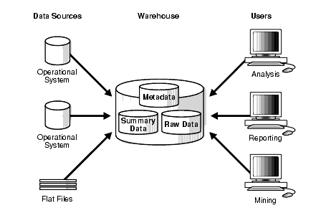
Inmon's Data warehousing Approach
Enterprise DW
Normalized Data Model
Data Integration
Data Staging
Data Marts (subset of DW)
Long Term Strategic Perspective

Slide 22
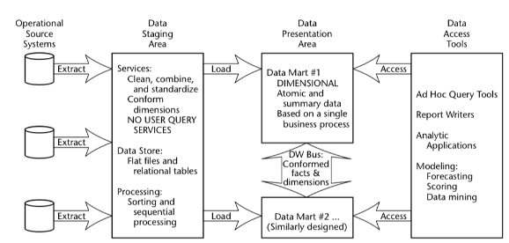
Kimball's Data warehousing Approach
Dimensional Data Modelling
Star and Snowflake Schema
Data Mart-Centric
Iterative Development
Business User Empowerment
Botton-Up Scalability

Slide 23
Kimball's vs Inmon's Approach
Parameter | Kimball's Approach | Inmon's Approach
Philosophy | Bottom-Up Approach | Top-Down Approach
Centralization | Emphasizes decentralized data marts | Advocates for a centralized Enterprise Data Warehouse (EDW)
Data Integration | Data Marts are independently integrated | Extensive data integration process
Data Marts | Business specific and tailored | Derived from centralized DW
Development Approach | Iterative and Incremental | Long-term strategic
User Empowerment | Prioritizes business user empowerment | Focuses on building a robust foundation for EDW
Data Modelling | Dimensional | Normalized
Scalability | Botton-Up | Top-Down
Agility | Agile Approach | Strategic Approach

Slide 24
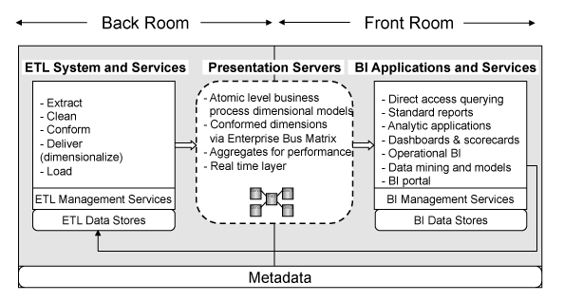
Kimball's front and back room analogy
Front Room (User-Facing)
Back Room (Technical)

Slide 25


